Slide 1






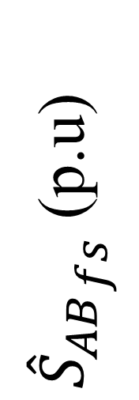









$$1.2$$
Maximum
$$m_{a}=1$$
Minimum
$$0.8$$
${{\hat{S}}_{AB}}_{fs}$ (p.u)
$$m_{a}=0$$
$$m_{a}=0.75$$
$$m_{a}=0.25$$
$$m_{a}=0.5$$
$$0.4$$
$$0$$
$$0$$
$$2π$$
$$4π$$
$$6π$$
$$8π$$
$$10π$$
Fundamental phase (rad)

Slide 2

$$1.2$$
Maximum
$$m_{a}=1$$
Minimum
$$0.8$$
$${{\hat{S}}_{AB}}_{fs}$$
$$m_{a}=0$$
$$m_{a}=0.75$$
$$m_{a}=0.25$$
$$m_{a}=0.5$$
$$0.4$$
$$0$$
$$0$$
$$2π$$
$$4π$$
$$6π$$
$$8π$$
$$10π$$
Fundamental phase (rad)

Slide 5




Maximum
Controllable
Region
${{\hat{S}}_{AB}}_{fs}$ (p.u)
Uncontrollable
Region
$$0.44$$
Minimum
Modulation index ($m_{a}$)
$$0.88$$

Slide 6
Maximum
Controllable
Region
${{\hat{S}}_{AB}}_{fs}$ (p.u)
Uncontrollable
Region
$$0.44$$
Minimum
Modulation index ($m_{a}$)
$$0.88$$

Slide 7

Maximum
Controllable
Region
${{\hat{S}}_{AB}}_{fs}$
Uncontrollable
Region
$$0.44$$
Minimum
Modulation index ($m_{a}$)
$$0.88$$

